Slide 1
HSC Data Analysis
Now we have NAPLAN, so what?

Slide 2
1 The same story….
with some tweaks.

Slide 3
The essential story
Using School Certificate
Using NAPLAN
“How did our students go in this HSC course, compared with similar* students in other Catholic Schools?”
* - “Similar”: Gender, SES, prior achievement two years ago.
“How did our students go in this HSC course, compared with similar* students in other Catholic Schools?”
* - “Similar”: Gender, SES, prior achievement over all of secondary school.
Hence, the tweak on the story: from a difference created in the last two years of school, to a whole-of-secondary-school effect.

Slide 4
2 How strong a model does NAPLAN give you?...
… compared to one based on the School Certificate

Slide 5
You wouldn’t expect NAPLAN to give you as strong a base, because it’s longer ago…
School Certificate
NAPLAN

Slide 6
Conclusion:
NAPLAN gives a somewhat (14%) weaker base (than SC) for Analysis, but it is still quite statistically adequate to frame useful questions about teaching and learning – particularly when these can be in a whole-of-secondary perspective.

Slide 7
3 How does the NAPLAN base compare with SC in the Analysis
The unique position of the 2013 cohort

Slide 8
Investigate a standard-form Primary Analysis….
This distance is the key variable, “MnDiff”, showing the difference between the position of the ellipse and the Achieved = Typical line.
Achieved
Our question becomes, “How similar are the values of MnDiffNap (calculated using NAPLAN as the base) to MnDiffSC?”
Typical

Slide 9
Investigate a standard-form Primary Analysis….
This distance is the key variable, “MnDiff”, showing the difference between the position of the ellipse and the Achieved = Typical line.
Achieved
It is possible of course that the NAPLAN result could look very different to that based on School Certificate
Typical

Slide 10
Think of the possibilities we could find for the relationship between MnDiffNAP and MnDiffSC
Possibility 1: there’s no relationship at all. What would that look like?
What conclusion would you draw from this sort of result?

Slide 11
Think of the possibilities we could find for the relationship between MnDiffNAP and MnDiffSC
Possibility 2: they are absolutely related. What would that look like?
What conclusion would you draw from this sort of result?

Slide 12
Well what did we actually find?
(small drum roll please…)

Slide 14
Conclusion:
The HSC Data Analysis based on NAPLAN gives a similar picture of achievement vs what is Typical to that provided by the Analysis based on School Certificate.

Slide 15
4 The Naplan data used
Choices, reasons for them, and effects

Slide 16
Literacy and Numeracy, 9 & 7
Numeracy result is used as a stand-alone mark
Literacy = (Reading + Writing +(GrammarPunctuation + Spelling)/2)/3
Chose Literacy rather than the individual components because:
  Intuitively meaningful
  Reduces number of variables, hence helps models to resolve
  Enables better dealing with missing data
Surprised to find that Year 7 results still have an independent relationship with HSC
  Even though it is often small
  Or sometimes negative – there’s a story there.

Slide 17
Accessing your NAPLAN data
Download Data > All Data
oBOSTES had difficulty getting good matches for 2009 Year 7, so you may find some data missing where you can access it through SmartData
Thanks to all Diocesan Officers who were able to do the 2011/2009 data dump to enable the process to start.
The Missing Data facilities in the Analysis were used this year; previously, students needed a complete set of SC results to be included. From this year, values for some missing data could be estimated by relationships within the analysis.
As a minimum, some of the Year 9 results were needed.
The facts that the missing data estimations were used, and that NAPLAN is a national test, meant that a larger rather than smaller percentage of students were included in the 2014 Analysis.

Slide 18
5 Observed effects in the Analysis
Only four so far, but can you see more?

Slide 19
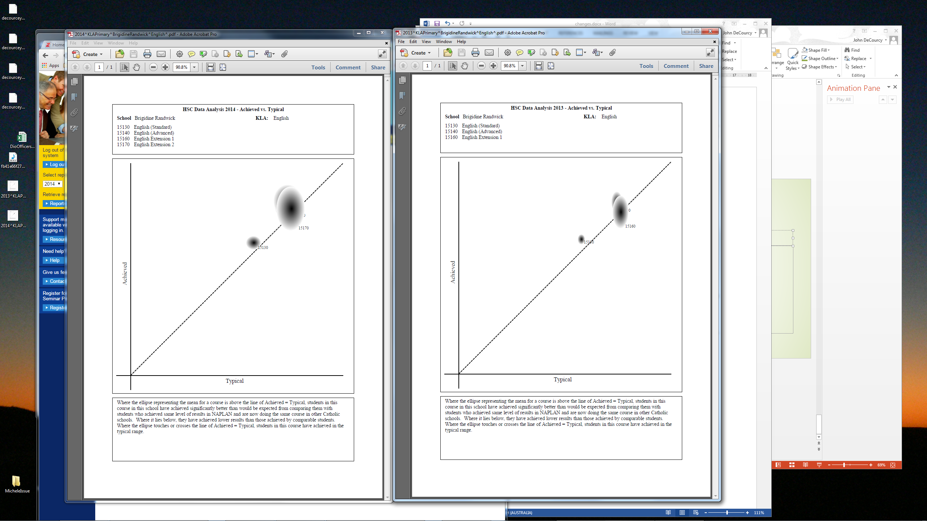
Effect #1: Ellipses are wider
2013, on SC
2014, on NAPLAN
Slightly weaker model > Slightly larger uncertainties > Slightly wider ellipses

Slide 20
Effect #2: Decrease in the number of out-of-range-of-Typical results
In 2013, across all courses done with a SC base, there were:
  331 “Achievement Above Typical Range” results
  3001 “In the Typical Range”
  369 “Below the Typical Range”
In 2014, across all courses done with a NAPLAN base, there were:
  191 “Above typical”
  3113 “in the Typical Range”
  179 “Below the Typical Range”
Slightly weaker model > Slightly larger uncertainties > Slightly wider ellipses > more cut the line of Achieved=Typical > Fewer out-of-range

Slide 21
Effect #3: Increase in the ratio between Above and Below Typical
In 2013, across all courses done with a SC base, there were:
  331 “Achievement Above Typical Range” results
  3001 “In the Typical Range”
  369 “Below the Typical Range”
  i.e., 38 fewer results above than below
In 2014, across all courses done with a NAPLAN base, there were:
  191 “Above typical”
  3113 “in the Typical Range”
  179 “Below the Typical Range”
  i.e., 12 more results above than below.
Is this an artifact of the open-ended nature of the NAPLAN scale?

Slide 22
Effect #4: Small class exclusion
Previously, under SC, classes of about 4 or 5 were the smallest that would model.
Now, under NAPLAN, classes of about 5 or 6 are the smallest.
Slightly weaker model > Slightly larger uncertainties > Slightly wider ellipses > more non-significant results

Slide 23
6 Other changes in the 2014 Analysis
Mostly based on user requests

Slide 24
Other changes 2014
Two courses have new BOS numbers, so will have only one year appearing on their Trends graphs
  General Mathematics becomes Mathematics General 2 BDC
  26699 Information Technology Exam becomes 27399 Information and Digital Technologies Exam
Mathematics Extension 2 students now have all band reporting done as Notional Bands
“Typical” has replaced “Expected” as the description of the modeled result
All references to UAI are now gone – we use “TES” because this remains the basis of the ATAR (as it was for both UAI and TER).
The School Summary (Numeric Report 4) now includes the field “Diff”, which has always been its sorting field.
The meaning of the “Incl” figure in the Overall School Result has changed slightly, to be more accurately a reflection of Graph 3.
Report 8 has been removed. It was mostly a SC summary, and the NAPLAN equivalents can be gained from Download Data > All Data.
Scatterplot graph names have been reversed to make them consistent. (Ach vs Typ, rather than Typ vs Ach.)

Slide 25
How have our students gone in this HSC course, compared to similar students in other Catholic schools?

