Slide 1
Types of Data
Strengths, limitations and use

Slide 2
Data Type #1: Descriptions
Adam’s class participation has improved considerably over the term. He is now prepared to ask a question when he doesn’t understand a point. He can be disruptive in practical work with other students, and sometimes needs to be asked to work alone. His test result indicated good preparation.
E.g., Semester Reports!

Slide 3
Data Type #1: Descriptions
Something in this class I really learned from: I liked the way you showed us the example IN STEPS.
Something I didn’t understand: I don’t get the difference between a Report and a Review
What I need to do next: The exercise you gave us for homework
OR: class feedback

Slide 4
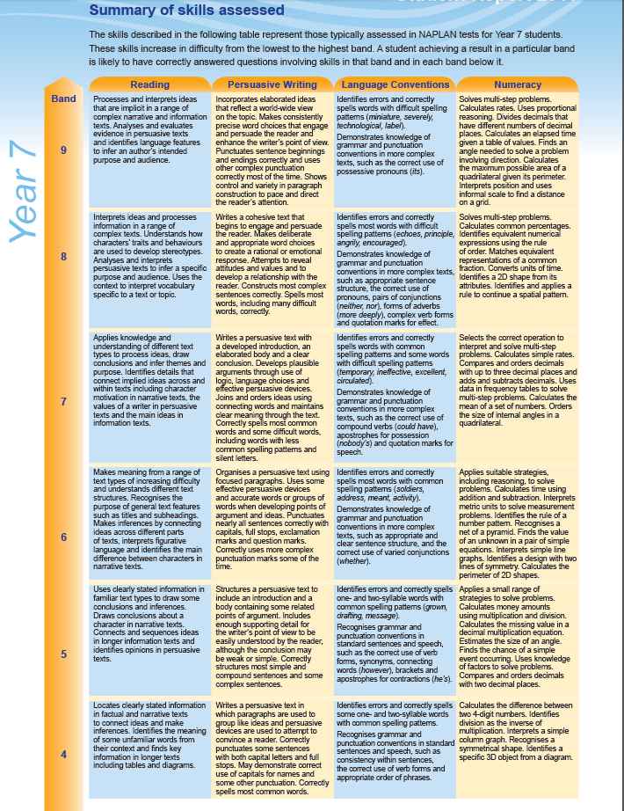
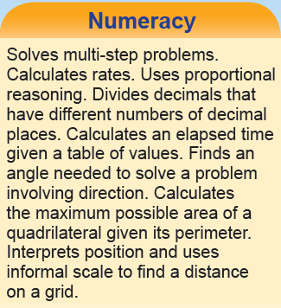
“Standards” are simply a ranked set of descriptions of either curriculum or achievement
Data Type #2: Standards

Slide 5
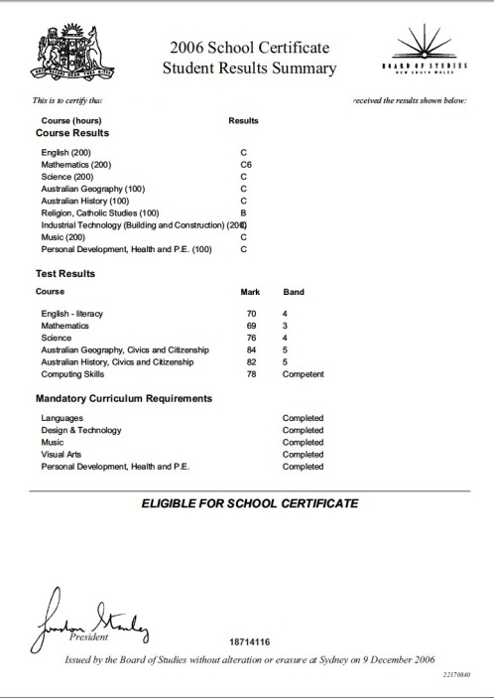
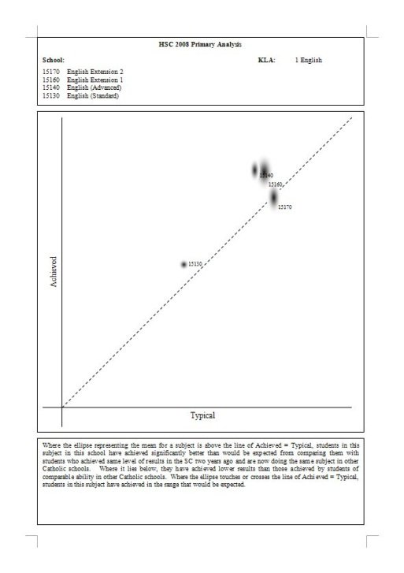
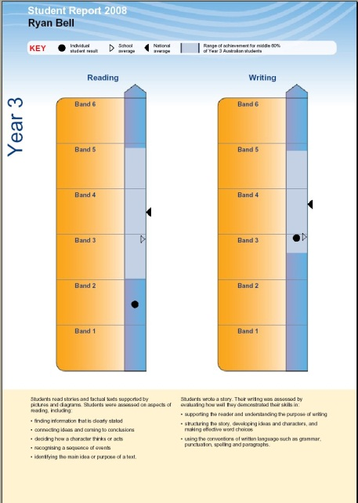
He scored 42/60 on the midyear test
She weighs 42kg
“Measures” combine a number and a unit
– either explicitly or graphically
There are 634 students in the school.
Data Type #3: Measures

Slide 6
Data Type #4: Indicators
Measure:
What does this indicate?
Construct:
Almost any measure can be an indicator of many different constructs – finding the most productive questions is the art of data analysis.
Top mark in the class, student has been studying well, highly motivated…
Wonderful learning?
Lowest he’s ever achieved, no sign of any preparation, smart student, easy test
Lazy?
He scored 42/60 on the midyear test
Whole class is showing improvement, class average is better than ever gained before…
Superb teaching?
Stole the answer sheet from the teacher’s desk the day before…
Dreadful cheat?
An “Indicator” is a measure or a standard that we relate to an underlying, not-directly-measurable, ‘Construct’
(e.g. ‘literacy’, ‘learning gain’, ‘quality of teaching’)

Slide 7
Qualitative
Quantitative
Descriptions
Indicators
When do you use each Data Type?
Types of Data
What are their strengths and limitations?
Measures
Standards

Slide 8
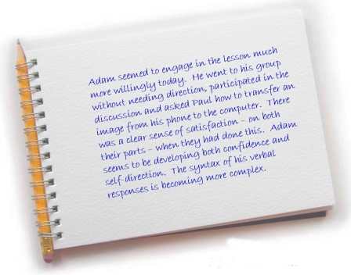
Data Type #1: Descriptions
The foundation of any good data or metric – if you can’t describe it clearly, you can’t communicate what you’re talking about
A professional learning conversation that focuses on accurately describing something can reveal quite different underlying assumptions.
Can be text, podcast, photo, video…
Limitation is that by themselves they lack context
Strength is the immediacy of their connection with the student

Slide 9
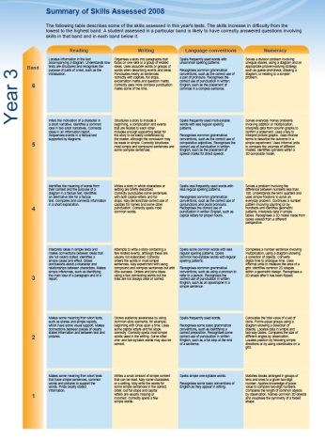
A bridge between the immediacy of a description and the precision of a measure
There’s a logical conundrum in standards: do you develop them in advance or after the assessment??
Strength is the ability to give you an implied map of learning progress
Limitation is the demand on Consistency of Teacher Judgment
Data Type #2: Standards

Slide 10
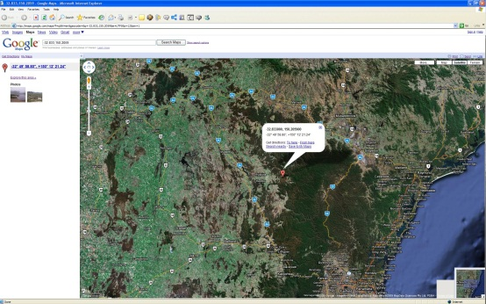
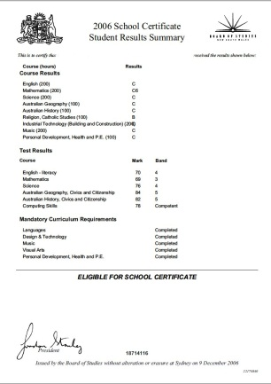
Measures are seductive with their apparent precision
A strength is the way in which measures can be easily aggregated to class, school and system levels.
Limitations include:
The loss of detail in collapsing learning (or any other construct) to a number
Unexamined assumptions about the relationship of the measure to the construct
The frequency with which people ignore confidence limits
Data Type #3: Measures

Slide 11
Data Type #4: Indicators
Indicators are our commonest and most challenging data type
A ‘Leading’ indicator relates to a construct in the future; a ‘lagging’ indicator tells you about something that’s happened in the past. (Think of the construct ‘achievement’ and then how measures of academic self-concept and test scores relate.)
A ‘Change’ indicator is constructed from the difference over time in two measures; an ‘Instance’ indicator gives just a point in time.
A ‘Strong’ indicator is arguably closely related to the underlying construct, but a weak one is not. (Think test scores and the constructs of achievement and pedagogy.) ‘Strength’ combines the ideas of validity and reliability.
A ‘Robust’ indicator can’t be ‘fiddled’ very easily; a Fragile one can. (Think of asking how many computers you have in your school… then sending out money based on how few you have.)
4 questions to ask about any indicator – is it…
Strong | or | Weak
Robust | or | Fragile
Leading | or | Lagging
Change | or | Instance

Slide 12
Use it to ask the right questions
Test the ‘Strength’ of the evidence: is it a sound link of measure-construct?
‘Triangulate’ the construct – what other way do I have of looking at it?
Using data well
Decide on a direction – go top-down, or bottom-up
Slice the data different ways: mean, top, bottom, time, individual map
Be suspicious of yourself: ask the next question

Slide 13
The data, used well, frame the good questions; Used poorly, they rush to judgment

